Slide 1
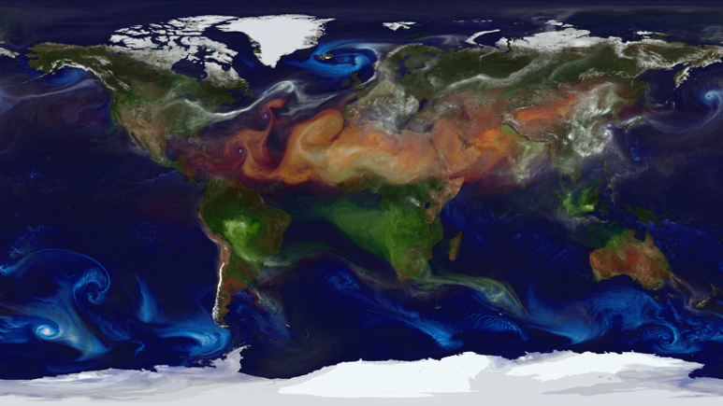

Simulation of Atmospheric Particle Movement
A Framework for Modeling Air Parcel Dynamics
Presented by
Supervisor
Diana Hujerat & Yasser Sadi
Zakharia Frenkel
Department
Group Code
Software Engineering
26-1-R-13
Page 1
Notes:
Good morning. We are presenting our project on the Simulation of Atmospheric Particle Movement. This work establishes a Lagrangian framework designed to model the complex dynamics of air parcels. Our core objective was to develop a robust simulation tool that moves beyond traditional grid-based methods. We focus on tracking individual parcels to gain fine-grained insight into atmospheric transport processes. This approach is essential for understanding how heat and moisture are distributed globally. We will now detail the motivation and physical background that underpin this simulation.

Slide 2

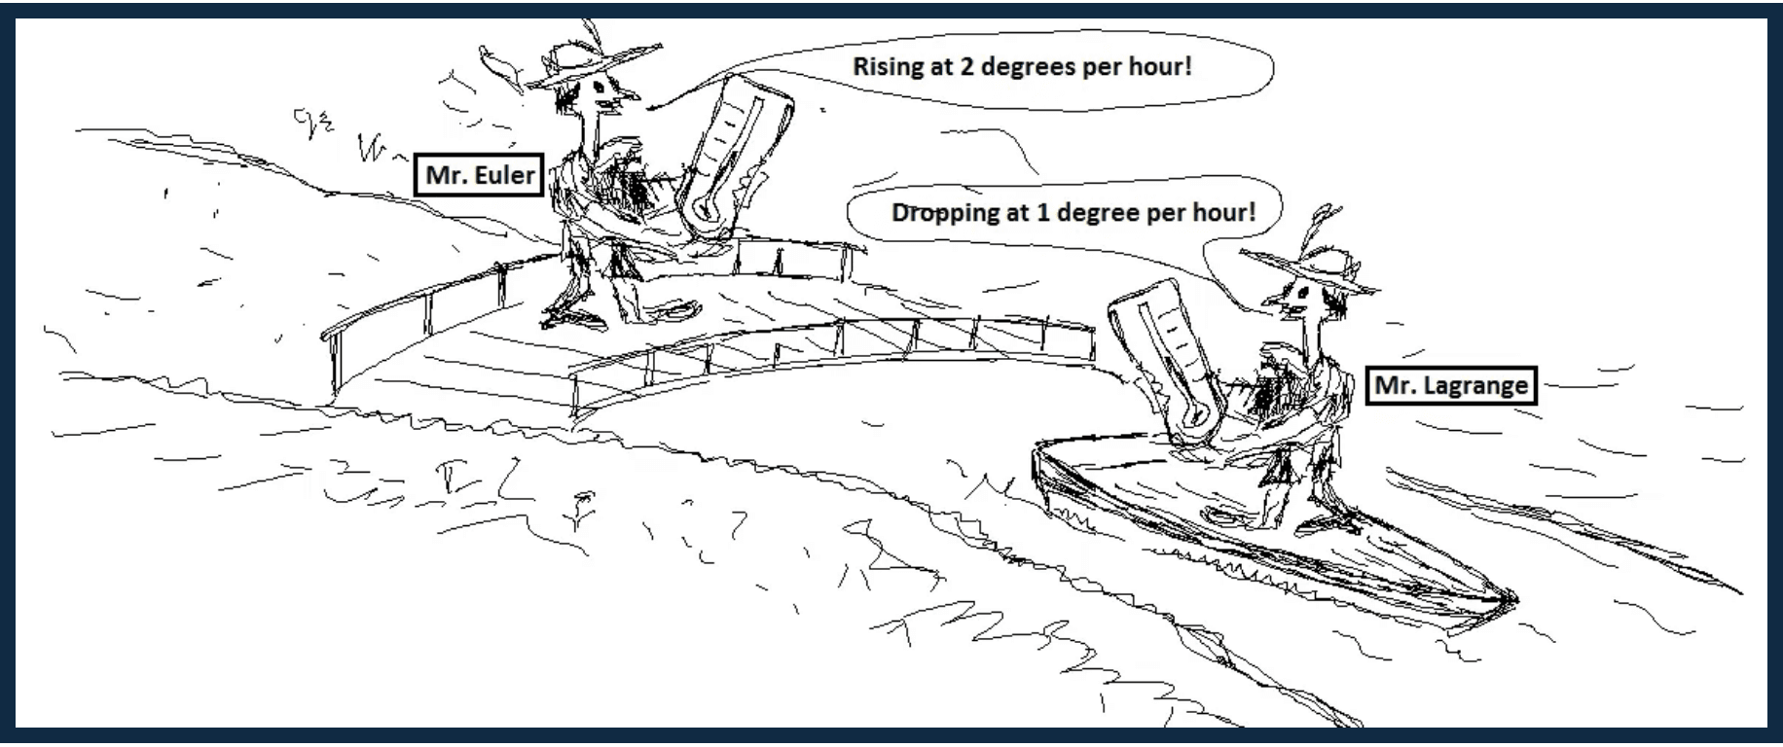
Project Overview & Motivation
The Problem
Atmospheric dynamics are complex and non-linear, making parcel tracking difficult in traditional fixed-grid systems.
The Need
Research tools that allow for controlled, parcel-scale investigation of convection and transport.
Our Solution
A Molecular Dynamics-inspired framework that tracks individual air parcels as discrete objects.
Page 2
Notes:
We begin by addressing the fundamental challenge: atmospheric dynamics are highly non-linear, making it difficult to track specific air masses using fixed-grid, or Eulerian, models. This limitation hinders research into small-scale processes like convection and localized transport pathways. Our solution is a Molecular Dynamics-inspired framework that treats air parcels as discrete, interacting objects. This Lagrangian approach allows us to capture the full thermodynamic history of each parcel, offering a powerful tool for controlled investigation. This shift in perspective is crucial for understanding the fundamental drivers of atmospheric circulation, which we will examine next.

Slide 3

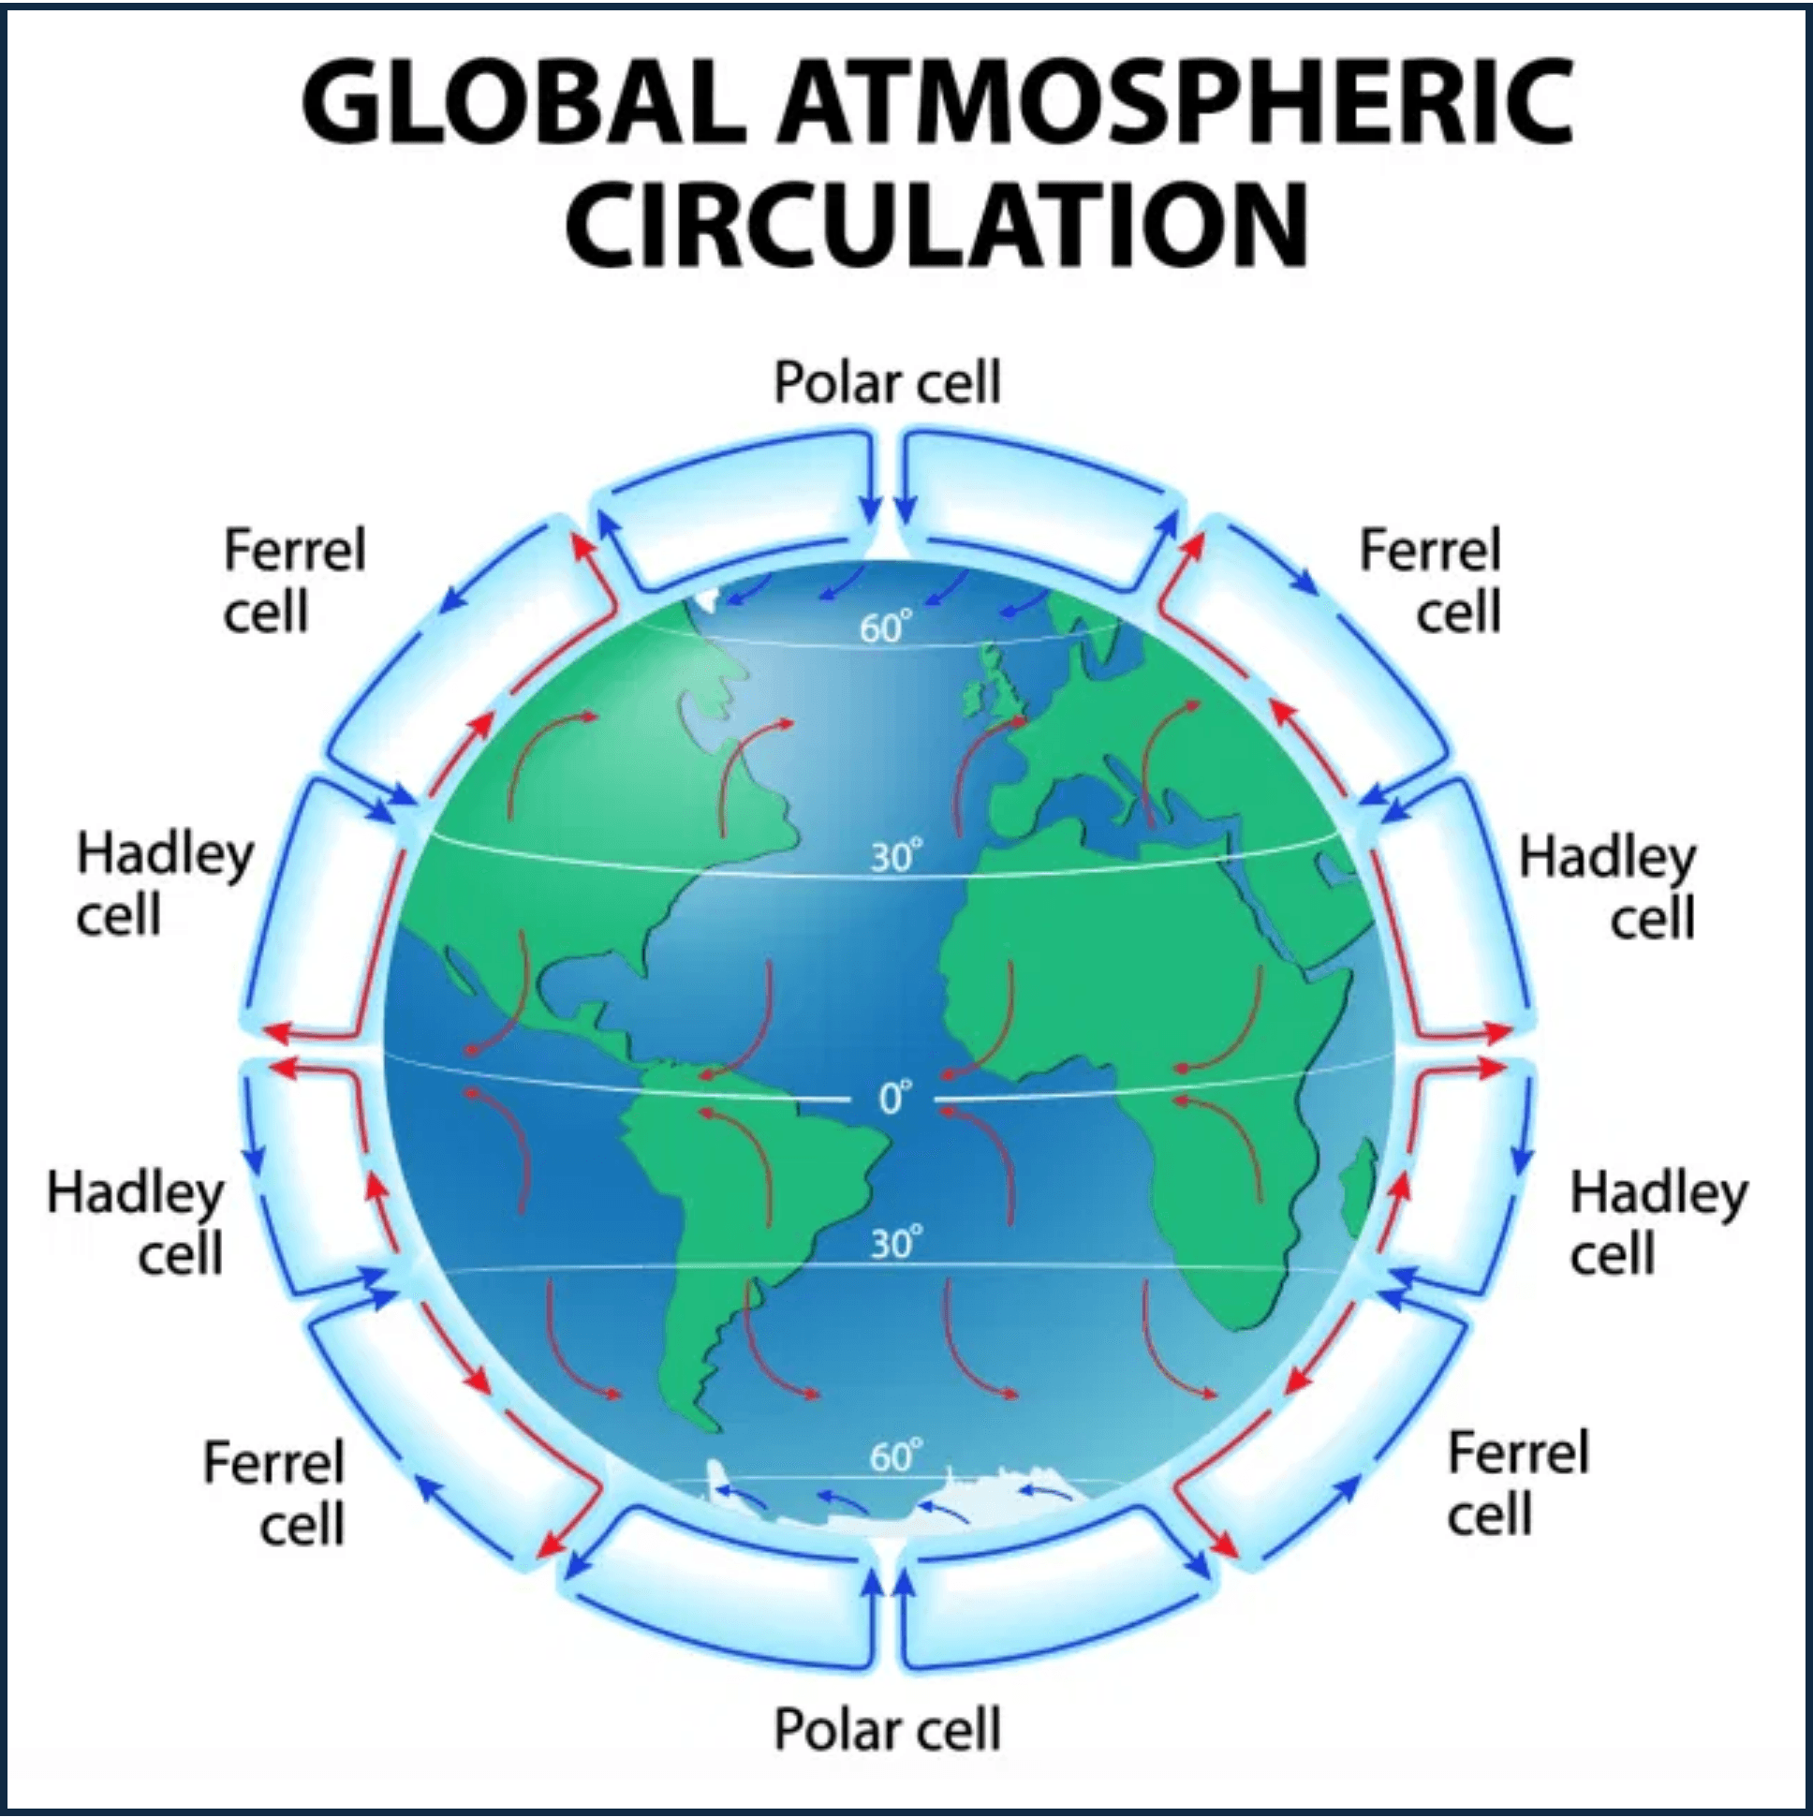
Physical Background & Global Circulation
Large-scale atmospheric flow is shaped by uneven solar heating and Earth's rotation, creating organized circulation patterns.
Hadley Cells
Warm air rises at the equator, moves poleward aloft, and sinks at 30° latitude.
Ferrel Cells
Mid-latitude circulation where air flows poleward and eastward near the surface.
Polar Cells
Cold air sinks at the poles and flows equatorward at the surface.
Page 3
Notes:
The physical background for our simulation is the global atmospheric circulation, which is primarily shaped by uneven solar heating and the Earth's rotation. These forces organize the atmosphere into predictable, large-scale patterns, namely the Hadley, Ferrel, and Polar cells. These cells govern the global distribution of wind and pressure, creating the essential background environment for our simulation. Our model must accurately represent these features to ensure that the simulated parcel trajectories are physically grounded and realistic. Understanding this large-scale context is vital before we delve into the specific forces acting on individual parcels.

Slide 4
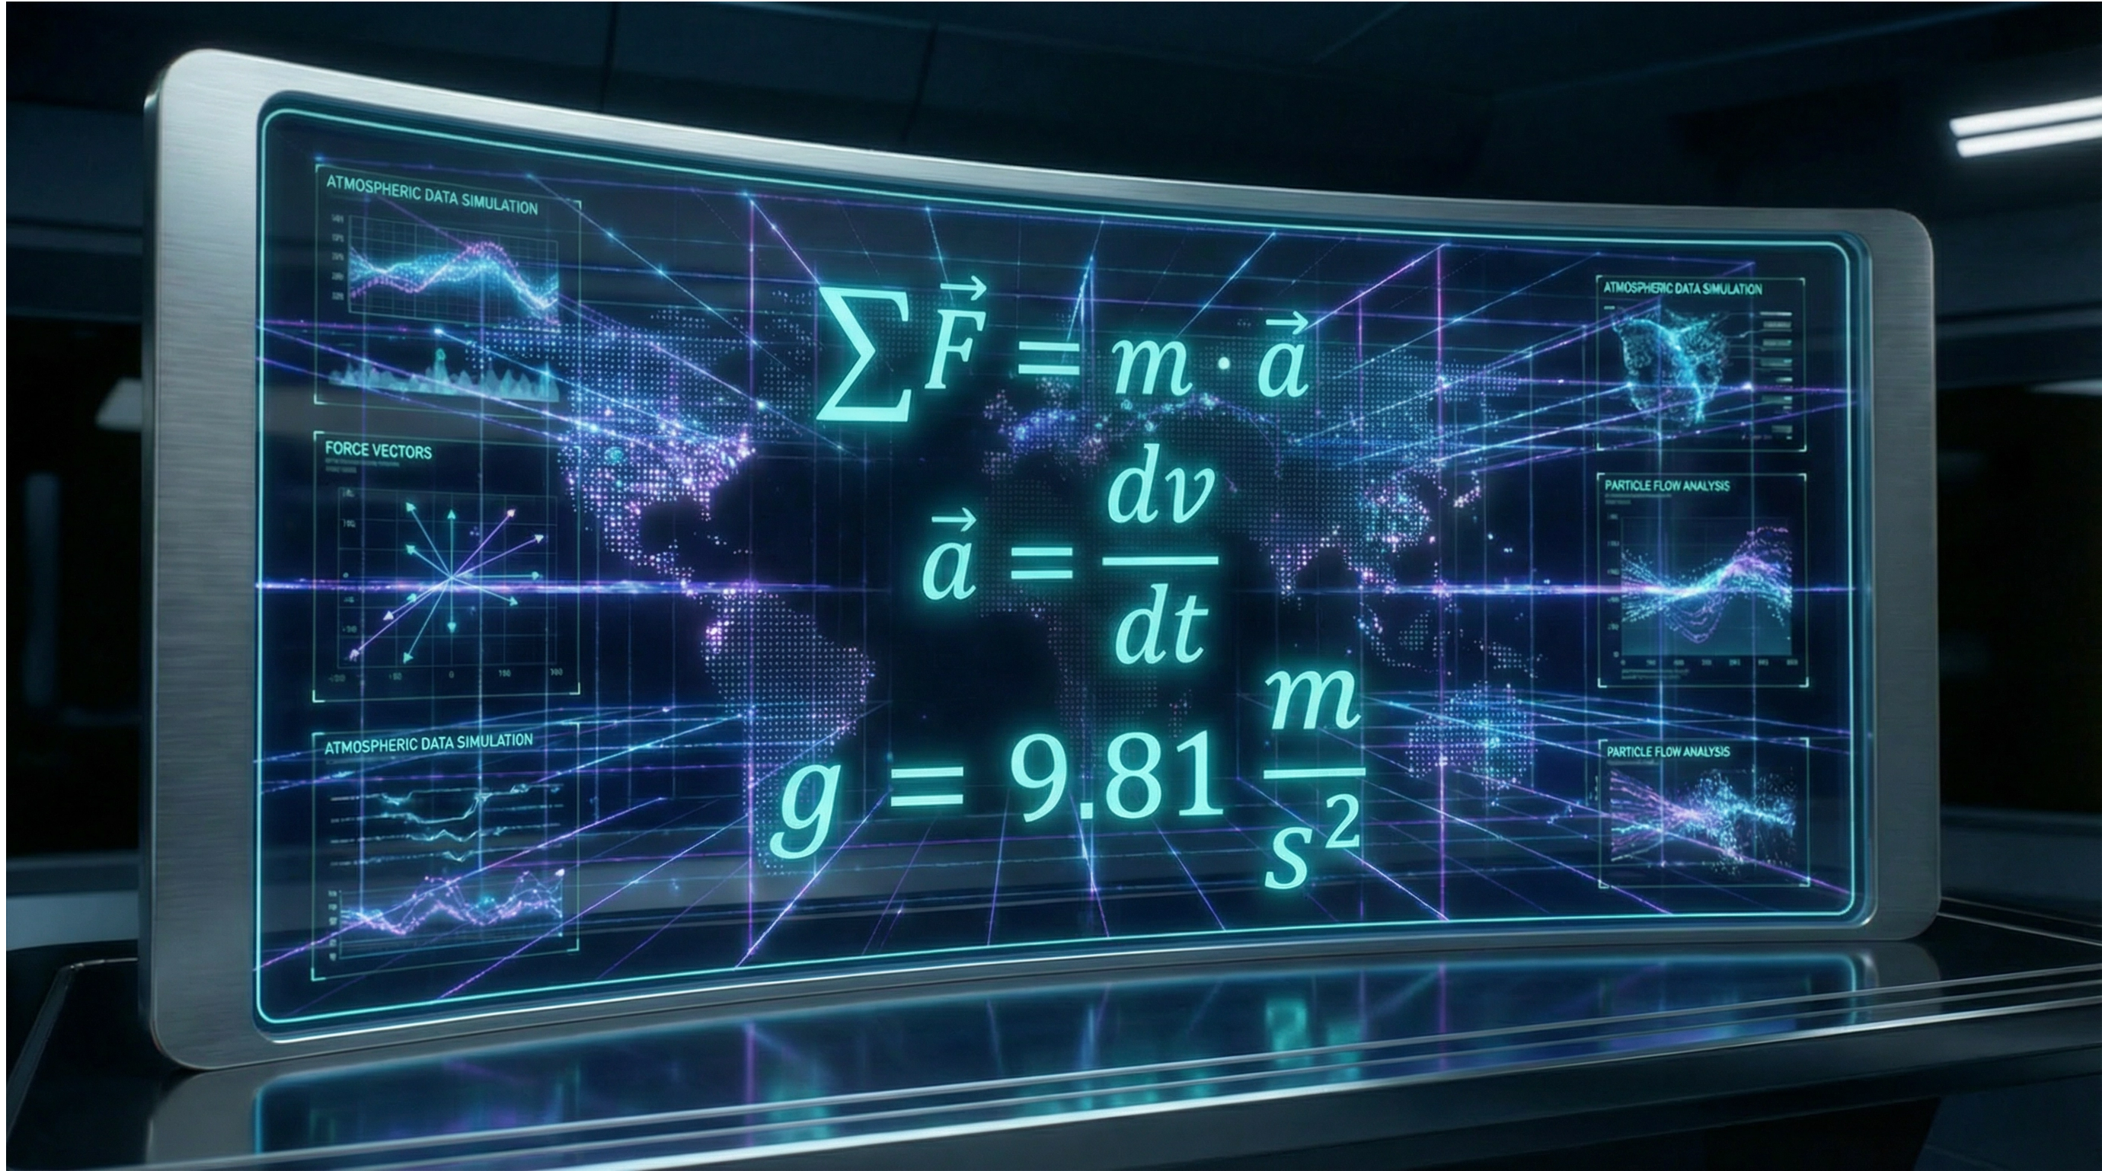
Fundamental Force Definitions
1. Fundamental Forces
Gravity Force
Direct gravitational acceleration on each parcel mass.
Interaction Force
Parcel-to-parcel interactions – Repulsion force
2. Emergent Forces
The following forces emerge from fundamental definitions and the rotating reference frame:
Buoyancy
: Thermal density differences.
Coriolis
: Earth's rotation effects.
Drag
: Relative motion resistance.
Page 4
Notes:
The motion of every air parcel is governed by Newton's Second Law, where the total acceleration is the summation of all acting forces divided by the parcel's mass. This formulation is the mathematical core of our Lagrangian model. We define the primary forces as gravity and an interaction force, which accounts for parcel-to-parcel dynamics. Other critical forces, such as buoyancy, Coriolis, and drag, are derived from these fundamental definitions and incorporated into the total force vector. By accurately modeling these forces, we can precisely track the evolution of each parcel, which is then managed through a structured workflow.

Slide 5
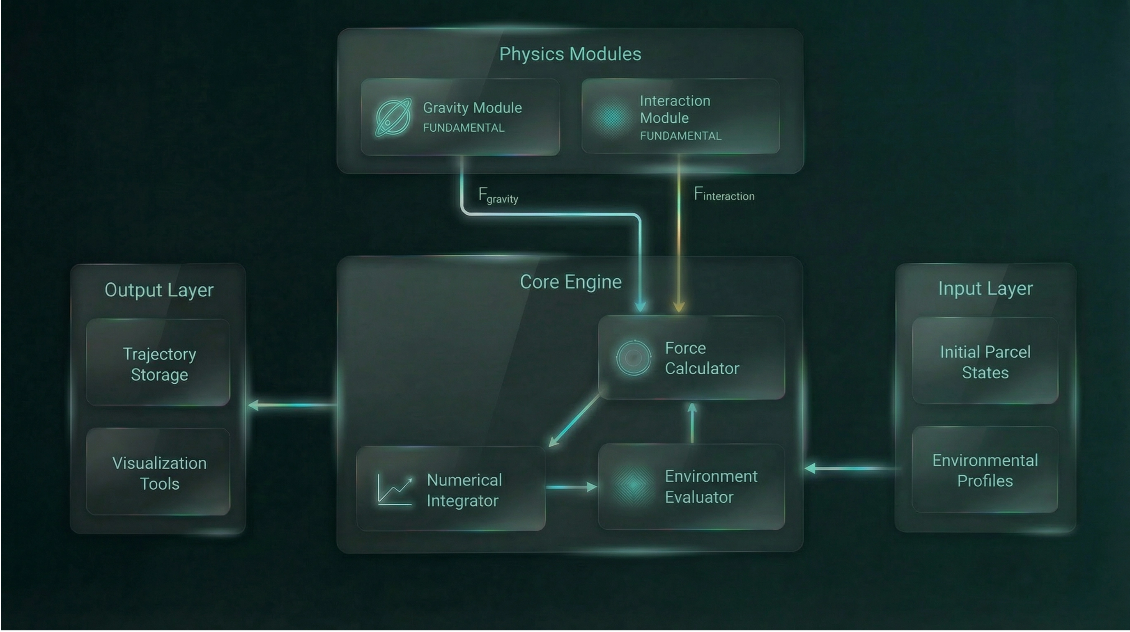
Software Architecture: Modular Design
Page 5
Notes:
Our system architecture is designed around a modular, three-part structure to ensure clarity and maintainability. This design separates the core physics engine from the analysis and visualization components. The Simulation module is the numerical engine, responsible for solving the equations of motion and generating the raw trajectory data. The Analysis module then processes this raw data, computing statistical metrics and physical diagnostics essential for interpreting the results. Finally, the Visualization module renders the 3D trajectories and the thermodynamic evolution, providing the necessary insight. This clear separation of concerns allows us to update the physical model without disrupting the analysis pipeline. We will now detail the core of the Simulation module: the numerical integration scheme.

Slide 6
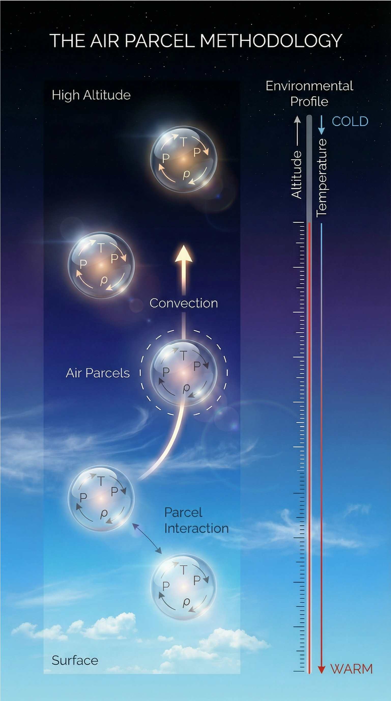
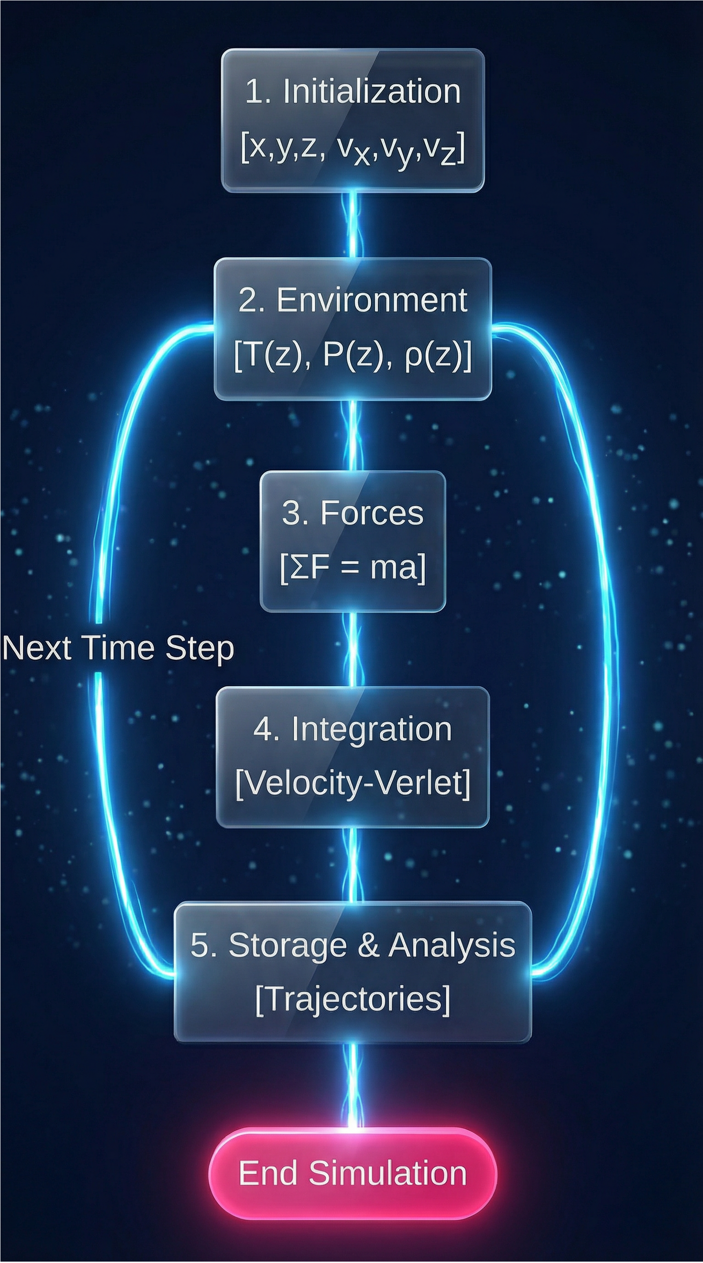
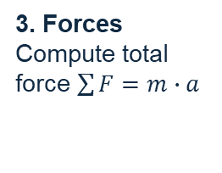
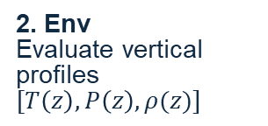
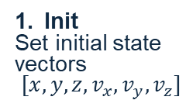
Simulation Workflow : Linear Execution
Init
Set initial state vectors
$[{x,y,z,v}_{x},v_{y},v_{z}]$
2. Env
Evaluate vertical profiles $[T\left(z\right),P\left(z\right),ρ(z)]$
3. Forces
Compute total force $\sum{F}=m∙a$
4. Integration
Apply Velocity-Verlet time integration.
5. Storage
Save trajectories for post-processing.
Page 6
Notes:
The simulation proceeds through a linear, five-step workflow, ensuring systematic execution and analysis. First, we initialize the state vectors for all parcels, defining their position and velocity. Next, the environment is evaluated to determine the background vertical profiles for temperature, pressure, and density. The third step is the force computation, where the total force acting on each parcel is calculated based on the governing laws we just discussed. Finally, we use the Velocity-Verlet integration scheme to update the parcel states, followed by storage of the trajectories for post-processing. This structured approach provides the necessary rigor for our simulation architecture.

Slide 7
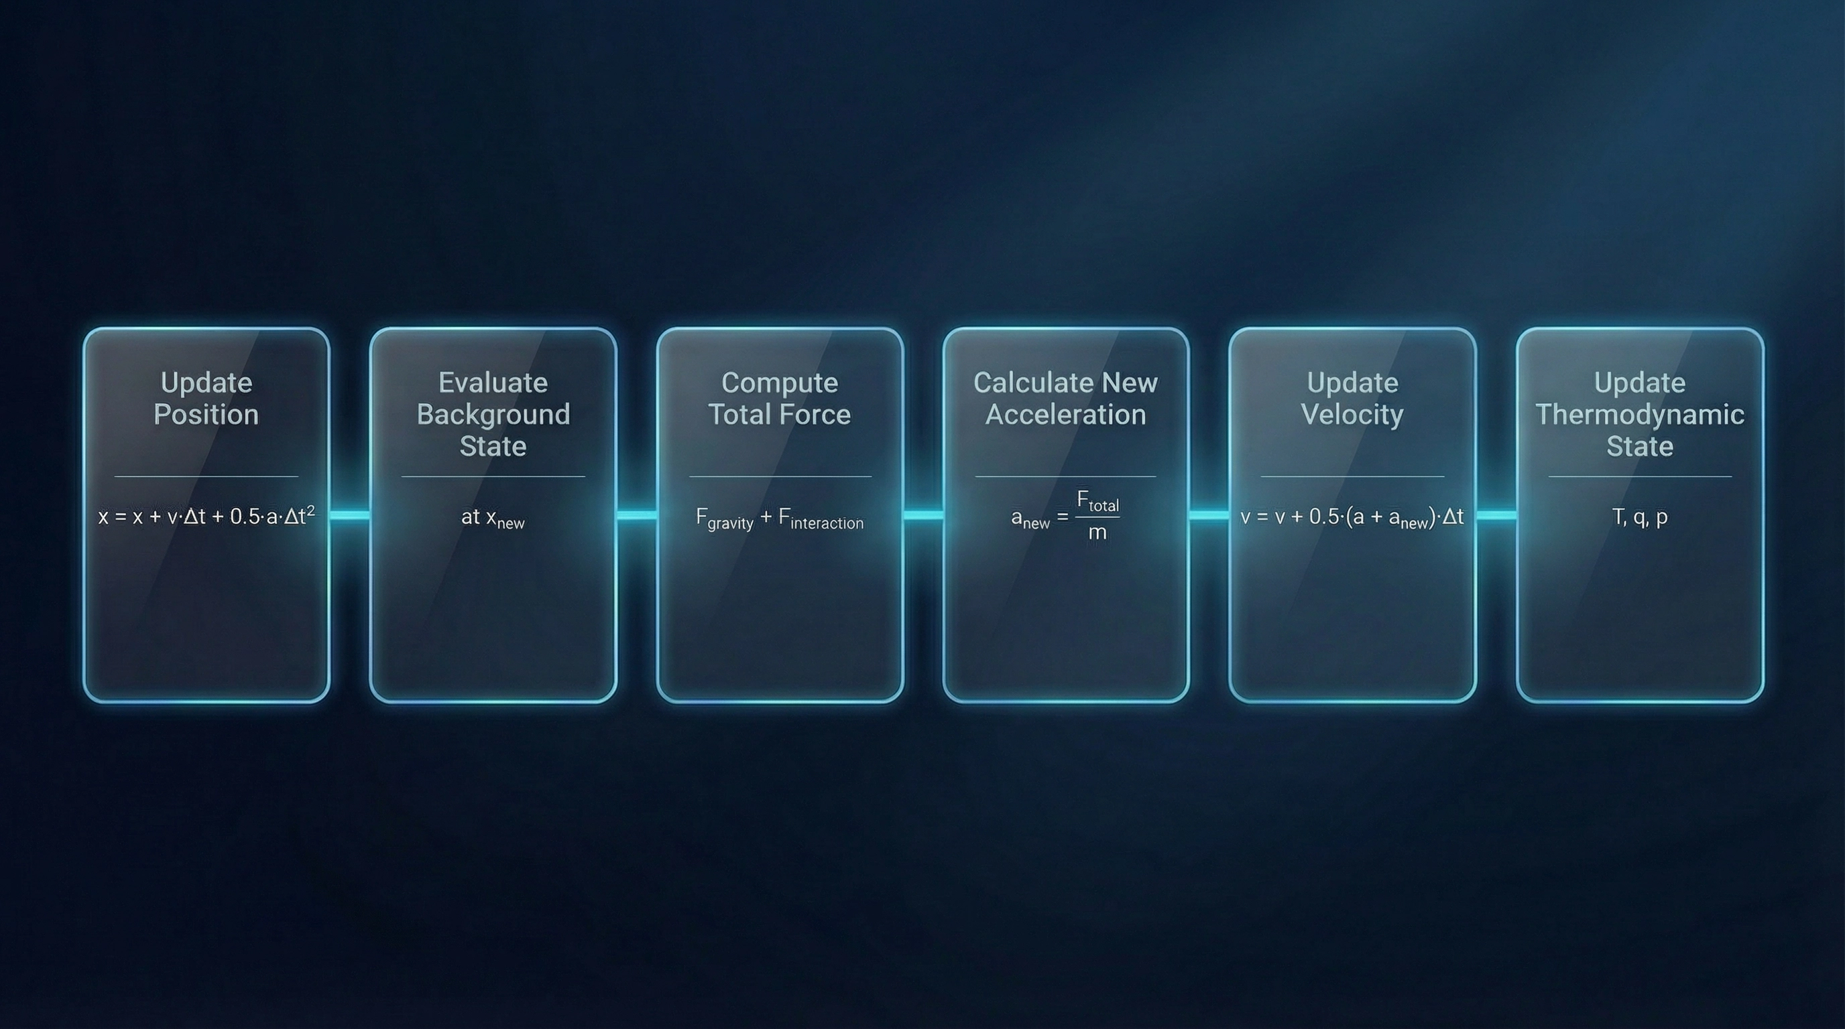
Numerical Integration: Zooming in Velocity-Verlet
Page 7
Notes:
Following the system architecture, the core of our simulation is the Velocity-Verlet integration scheme, chosen for its inherent stability. This method is symplectic, which is crucial because it ensures long-term energy conservation within the system. The total force driving the simulation is defined by the fundamental interactions between the air parcels and the background environment, including gravity and buoyancy. The implementation provides high-order accuracy for trajectory tracking by synchronizing the updates of both position and velocity. This robust numerical foundation is a key methodological innovation, which we will discuss next.

Slide 8
Innovation & Contribution
Methodological Innovation
Applying Molecular Dynamics integration techniques (Velocity-Verlet) to atmospheric parcel tracking, ensuring stability.
High-Precision Trajectories
Captures detailed thermodynamic history of individual air masses, a feature often lost in standard grid-based meteorological models.
Research Accessibility
Provides a lightweight, research-oriented tool for studying idealized convection without needing dedicated computers .
Strategic Positioning
Bridges the gap between simple kinematic trajectory models and complex, resource-intensive meteorological frameworks.
Page 8
Notes:
The methodological innovation of this project lies in adapting Molecular Dynamics techniques, specifically Velocity-Verlet, to atmospheric parcel tracking. This approach ensures energy conservation and numerical stability, which is a significant contribution. By tracking individual parcels, we achieve high-precision trajectories that capture the detailed thermodynamic history of air masses, a level of detail often absent in standard grid-based models. This framework strategically positions itself by bridging the gap between simple kinematic models and complex, resource-intensive meteorological simulations. This allows us to study idealized convection with high fidelity and low computational overhead. This fidelity is particularly important when considering moisture effects.

Slide 9

Moisture & Latent Heat Effects
Thermodynamic Coupling
Latent Heat Release
Moisture is treated as a prognostic variable carried by each air parcel. This coupling allows the simulation to account for humidity-driven density changes and phase transitions.
When a parcel cools below its saturation point, condensation occurs, releasing latent heat. This energy source warms the parcel, significantly boosting its buoyancy compared to dry air.
Page 9
Notes:
Moisture is a critical component of atmospheric dynamics, and we treat it as a prognostic variable carried by each air parcel. This thermodynamic coupling allows the simulation to accurately account for humidity-driven density changes and phase transitions. The key physical mechanism here is latent heat release: when a parcel cools below its saturation point, condensation occurs, releasing energy. This energy significantly boosts the parcel's buoyancy, leading to the intensification of convective development. The model successfully recovers the expected moist adiabatic lapse rate, confirming that this critical thermodynamic feedback loop is physically consistent. This consistency is maintained through careful attention to numerical stability.

Slide 10

Planned Testing & Validation Strategy
Numerical Stability
Physical Consistency
Planned convergence tests will confirm that air-parcel trajectories remain bounded. The target positional-norm difference between simulations with varying time steps is below 5%.
Planned comparison with analytical solutions for buoyant rise and Coriolis deflection aims for a relative error below 10% in idealized atmospheric test cases.
Sensitivity Analysis
Computational Efficiency
The model will be tested for smooth and continuous parcel response to variations in initial temperature, humidity, and drag coefficients to ensure no excessive sensitivity to small perturbations.
Planned benchmarks will verify linear scalability O(N). The goal is to ensure that doubling the number of simulated air parcels results in a proportional increase in computation time.
Page 10
Notes:
Having established the numerical stability of our integration schemes, we now detail the rigorous testing and validation strategy. Success hinges on confirming both the numerical accuracy and the physical fidelity of the model. We will measure numerical stability through convergence tests, targeting a positional error below five percent when varying the time step. Physical consistency will be verified by comparing our results against known analytical solutions for idealized cases, such as buoyant rise and Coriolis deflection. Furthermore, a sensitivity analysis will ensure that the model responds smoothly to small perturbations in initial conditions, preventing non-physical behavior. Finally, we must confirm the computational efficiency by benchmarking linear scalability, ensuring the framework remains viable for large-scale simulations. This systematic approach will confirm the model's reliability before we address the practical challenges of implementation.

Slide 11
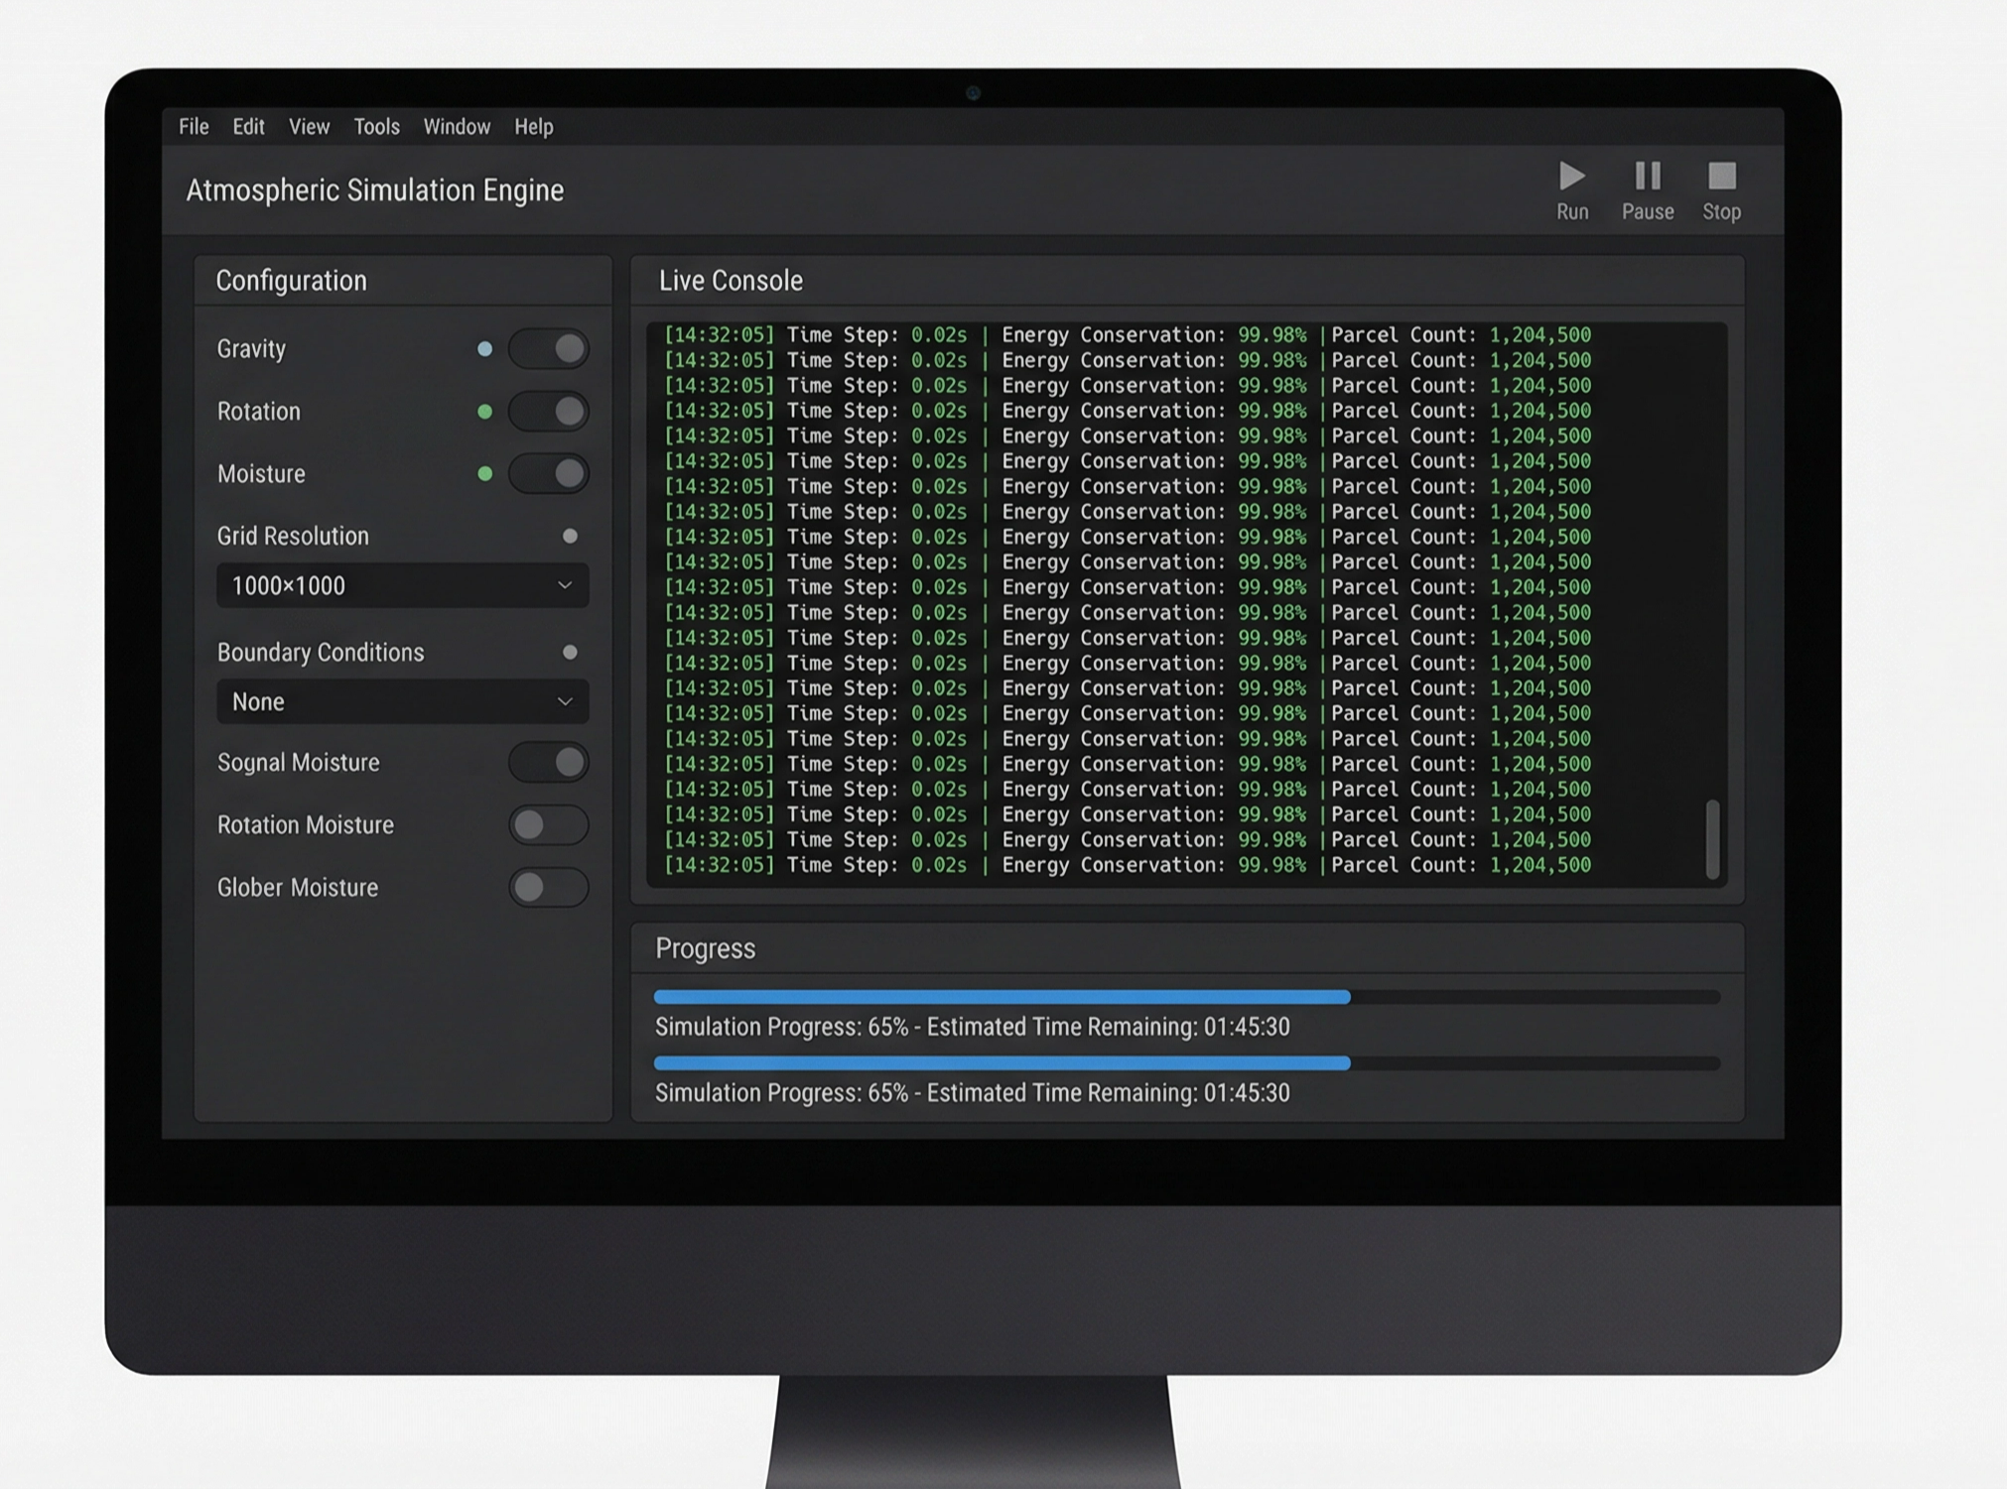
Simulation Program: Numerical Engine
Acts as the Computational Core of the project.
Numerically solves equations of motion for air parcels.
Responsible for Time Integration and Force Computation.
Operates as a batch-style program with structured data output.
Ensures physical correctness and numerical stability.
Page 11
Notes:
The simulation program is the computational core of this project, responsible for executing the physical model. Its primary function is the numerical solution of the equations of motion for every air parcel in the system. This engine handles the time integration and the complex computation of all forces, including buoyancy, drag, and Coriolis effects. Operating as a batch-style program, it is designed for structured data output, which facilitates downstream analysis. Ultimately, the engine's design prioritizes physical correctness and numerical stability, ensuring the integrity of the simulated trajectories. The raw output from this engine is then processed by our dedicated diagnostics tool.

Slide 12
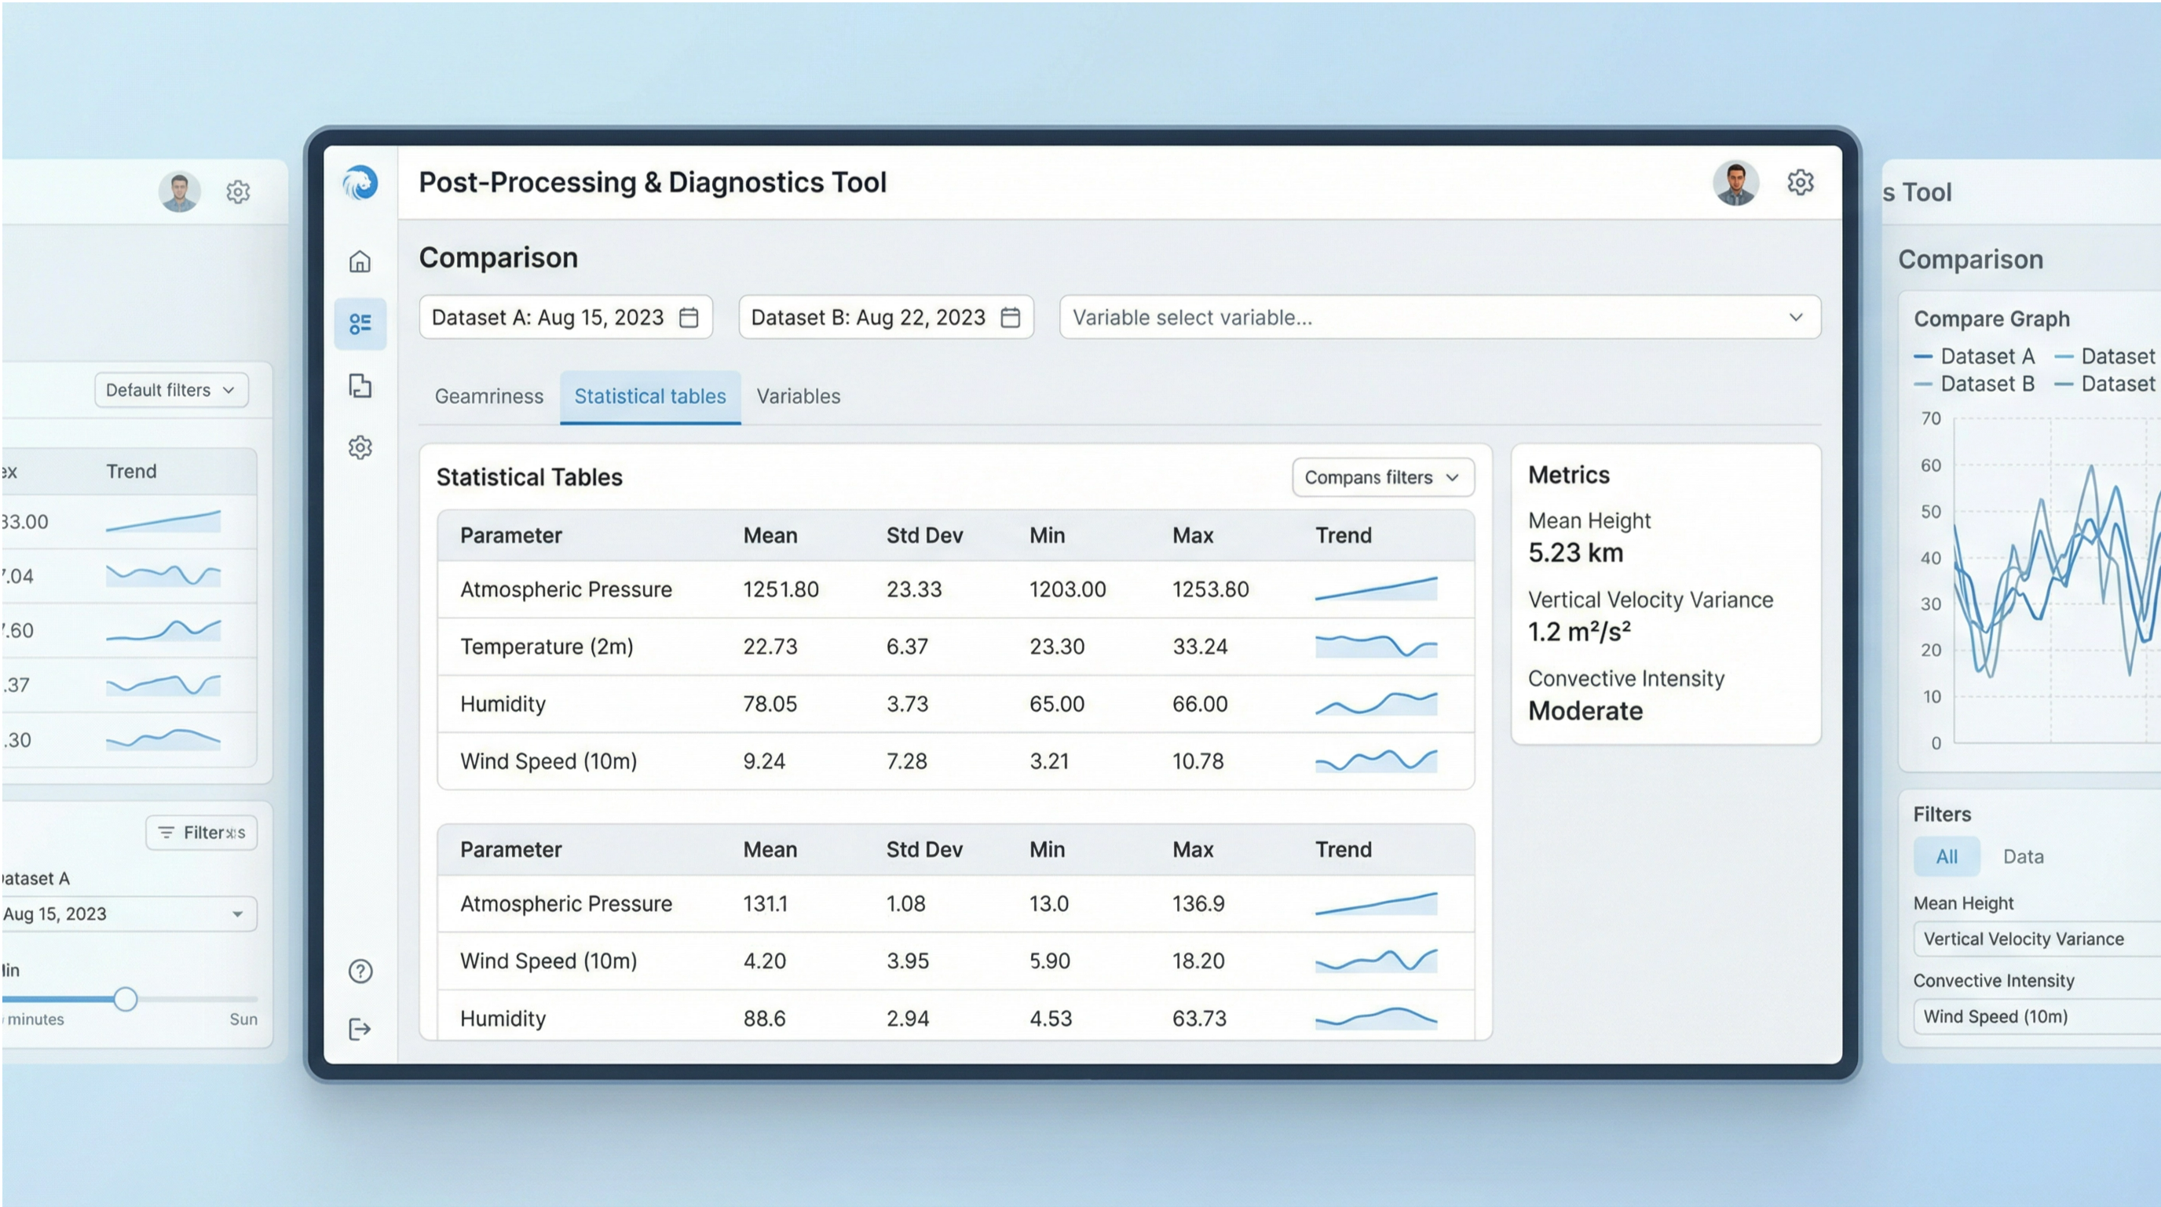
Analysis Program: Diagnostics Tool
Performs Quantitative Evaluation of simulation outputs.
Computes statistical measures and physical diagnostics.
Transforms raw trajectory data into meaningful metrics.
Enables Sensitivity Analysis and model validation.
Page 12
Notes:
The analysis program serves as our essential diagnostics tool, transforming raw simulation data into meaningful scientific metrics. This component performs the quantitative evaluation of the simulation outputs, which is critical for validation. It computes statistical measures and physical diagnostics, such as mean parcel velocity and mixing rates, that cannot be directly observed from the raw trajectories. By transforming the data, this tool enables the sensitivity analysis and the formal validation of the model against theoretical expectations. Crucially, it operates independently of the simulation runtime, allowing for flexible and post-hoc analysis. The final piece of our software architecture is the visualization tool.

Slide 13
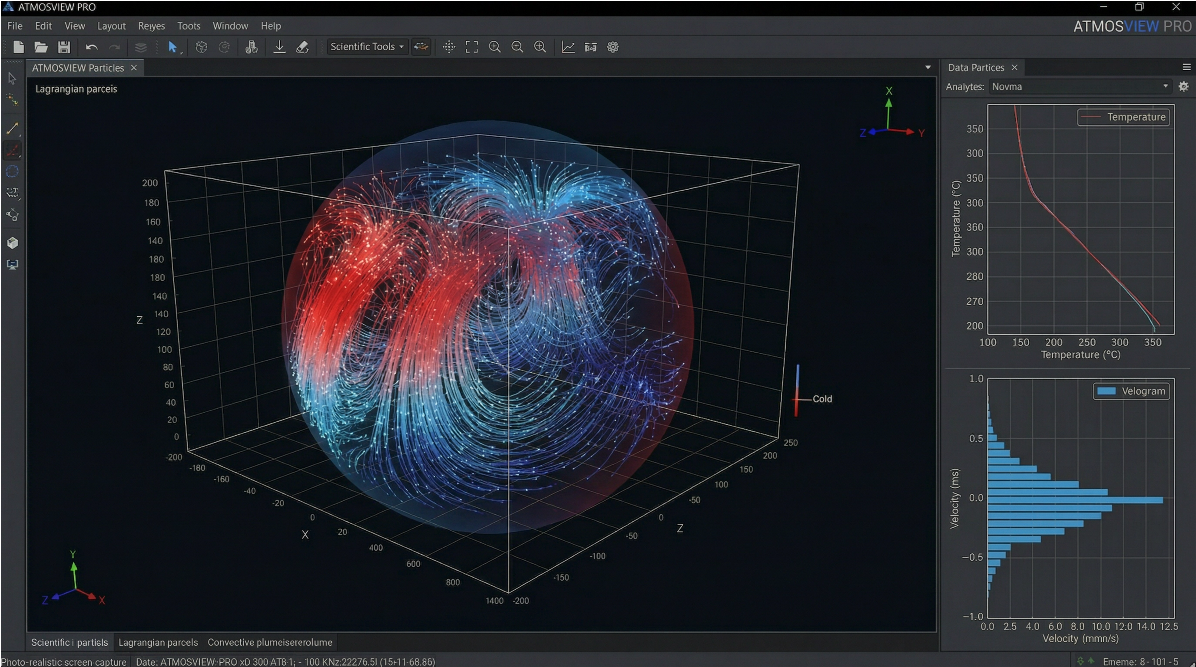
Visualization Program: Scientific Tool
Provides Graphical Representation of parcel dynamics.
Generates 3D trajectories and thermodynamic evolution plots.
Produces publication-quality figures and animations.
Supports Qualitative Validation of physical behavior.
Page 13
Notes:
The visualization program is our scientific tool for qualitative assessment and communication of results. It provides the graphical representation of the complex parcel dynamics we simulate. This tool generates 3D trajectories and plots the thermodynamic evolution of individual parcels over time. Its output is designed to produce publication-quality figures and animations, which are essential for communicating our findings. This visual component supports the qualitative validation of physical behavior, allowing us to observe and confirm the emergence of expected phenomena like convection and rotation effects. This three-part architecture—simulation, analysis, and visualization—forms a complete and robust framework for atmospheric research.

Slide 14

Anticipated Implementation Challenges
Numerical Stiffness
Computational Scalability
Rapid phase changes in moisture (latent heat release) can create stiff ODEs that challenge standard explicit integrators.
Tracking thousands of parcels with high-frequency force evaluations requires significant CPU/Memory resources.
Boundary Conditions
Data Management
Ensuring physical consistency at the surface and top-of-atmosphere boundaries in a scaled virtual world.
Storing and processing high-resolution 3D trajectory data for long-duration simulations.
Page 14
Notes:
Even with a robust design, we anticipate several implementation challenges that require specific mitigation strategies. The first is numerical stiffness, which arises from the rapid release of latent heat during phase changes in moisture. This stiffness can destabilize standard explicit integrators. We will mitigate this by implementing adaptive time-stepping, which adjusts the step size dynamically during intense convective events. Secondly, computational scalability is a concern, as tracking thousands of parcels requires significant resources. Our solution involves vectorized operations and exploring GPU acceleration to maximize throughput. We must also manage boundary conditions effectively in our scaled virtual environment, using soft reflective or periodic boundaries to maintain physical consistency. Finally, managing the high-resolution 3D trajectory data requires efficient binary storage formats and on-the-fly statistical reduction. These solutions ensure the project remains computationally feasible. Next, we detail the architecture of the software itself, beginning with the core numerical engine.

Slide 15

Thank You
Questions & Discussion
Simulation of Atmospheric Particle Movement

